Slide 1

Presentation Topic: Android
Course Title: Operating System
Course Code: ICT-2201
PRESENTED BY
COURSE INSTRUCTOR
Md. Mashrafi Rahman
IT-24034
Department of Information & Communication Technology
MBSTU
Dr. Nazrul Islam
Associate Professor
Department of Information & Communication Technology
MBSTU

Slide 2
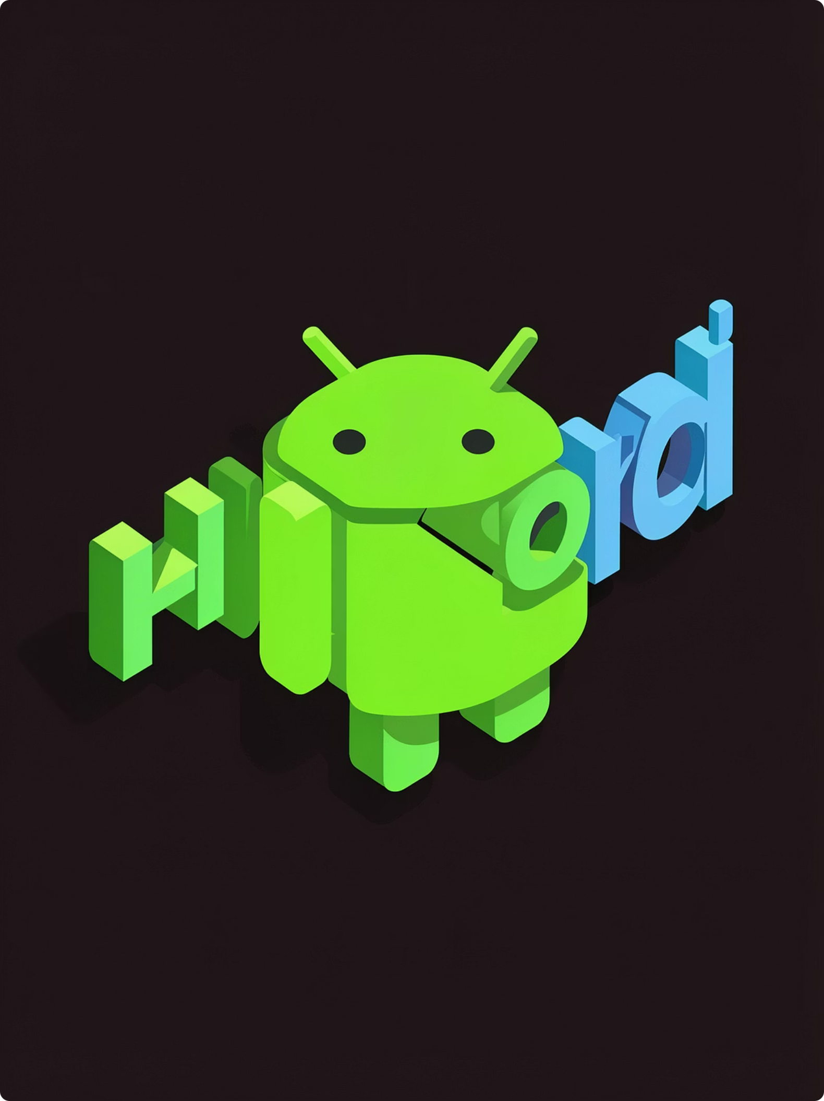
Android (operating system)
Android is a mobile operating system owned by Google, based on a modified Linux kernel and open-source software. Designed primarily for touchscreen devices (smartphones and tablets), Android has become the world’s most widely used mobile OS. The Android Open Source Project (AOSP) publishes the core code under permissive licenses, while most consumer devices run Google’s proprietary distribution that includes Google Mobile Services (GMS).

Slide 3
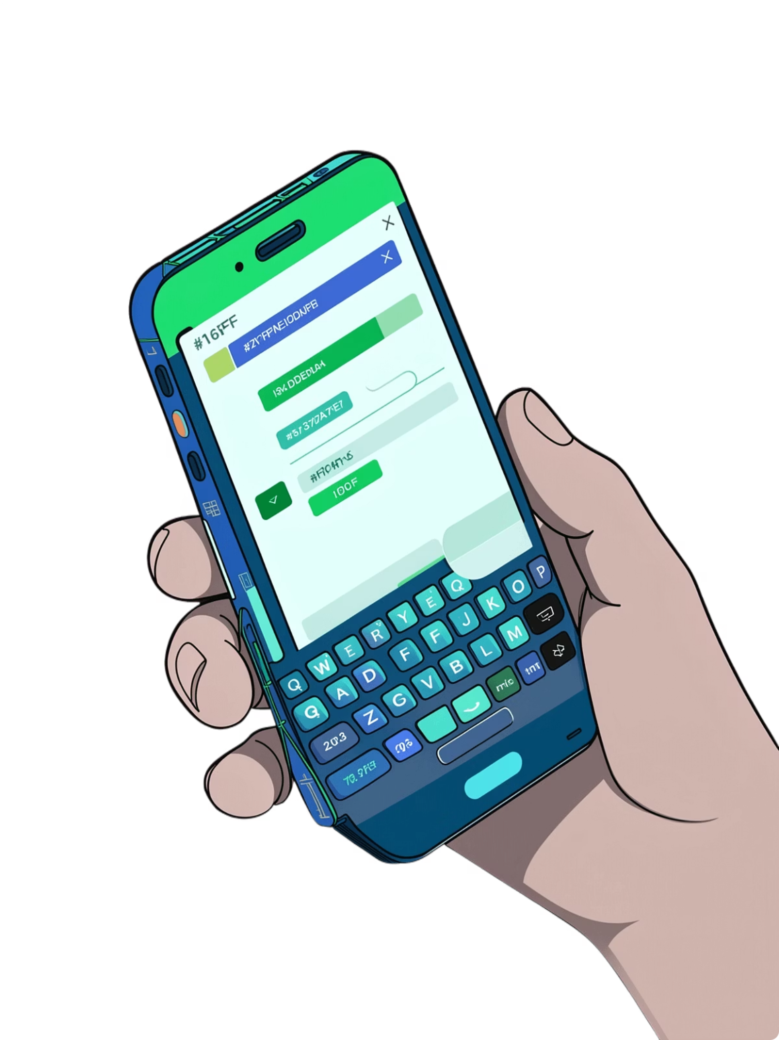
Origins & Early History (2003–2008)
Founding
Android Inc. was founded in Palo Alto in October 2003 by Andy Rubin, Chris White, Rich Miner and Nick Sears. The company pivoted from camera software to a phone OS in 2004.
Google acquisition
Google acquired Android in 2005; key team members joined Google and developed a mobile platform built on the Linux kernel.
First device
The first commercially available Android smartphone was the HTC Dream (T‑Mobile G1), announced September 23, 2008.

Slide 4
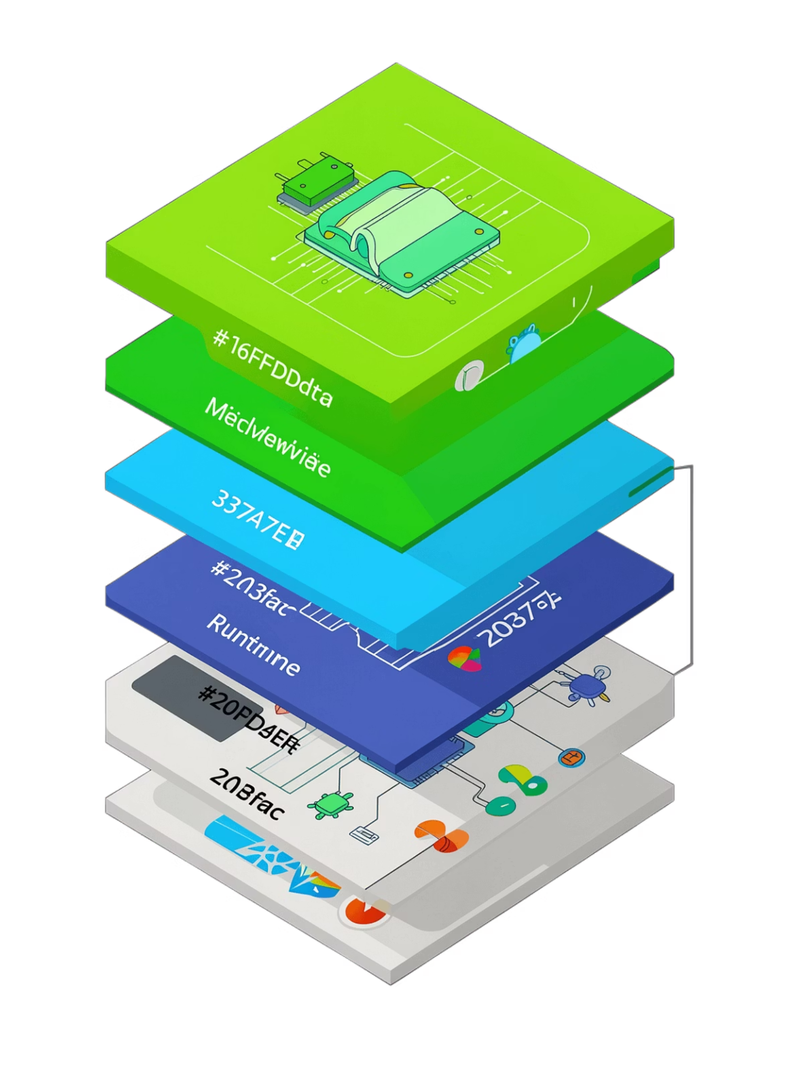
What Android Is Today (Structure & Ecosystem)
Android combines an open-source upstream (AOSP) with a large commercial ecosystem. Devices typically run a Google-branded Android with proprietary components (GMS, Play Store, core Google apps). Many OEMs customize Android with vendor UI skins; numerous forks and distributions (e.g., Amazon Fire OS, LineageOS) also exist. Android powers phones, tablets, wearables, TVs, cars and many IoT devices.

Slide 5
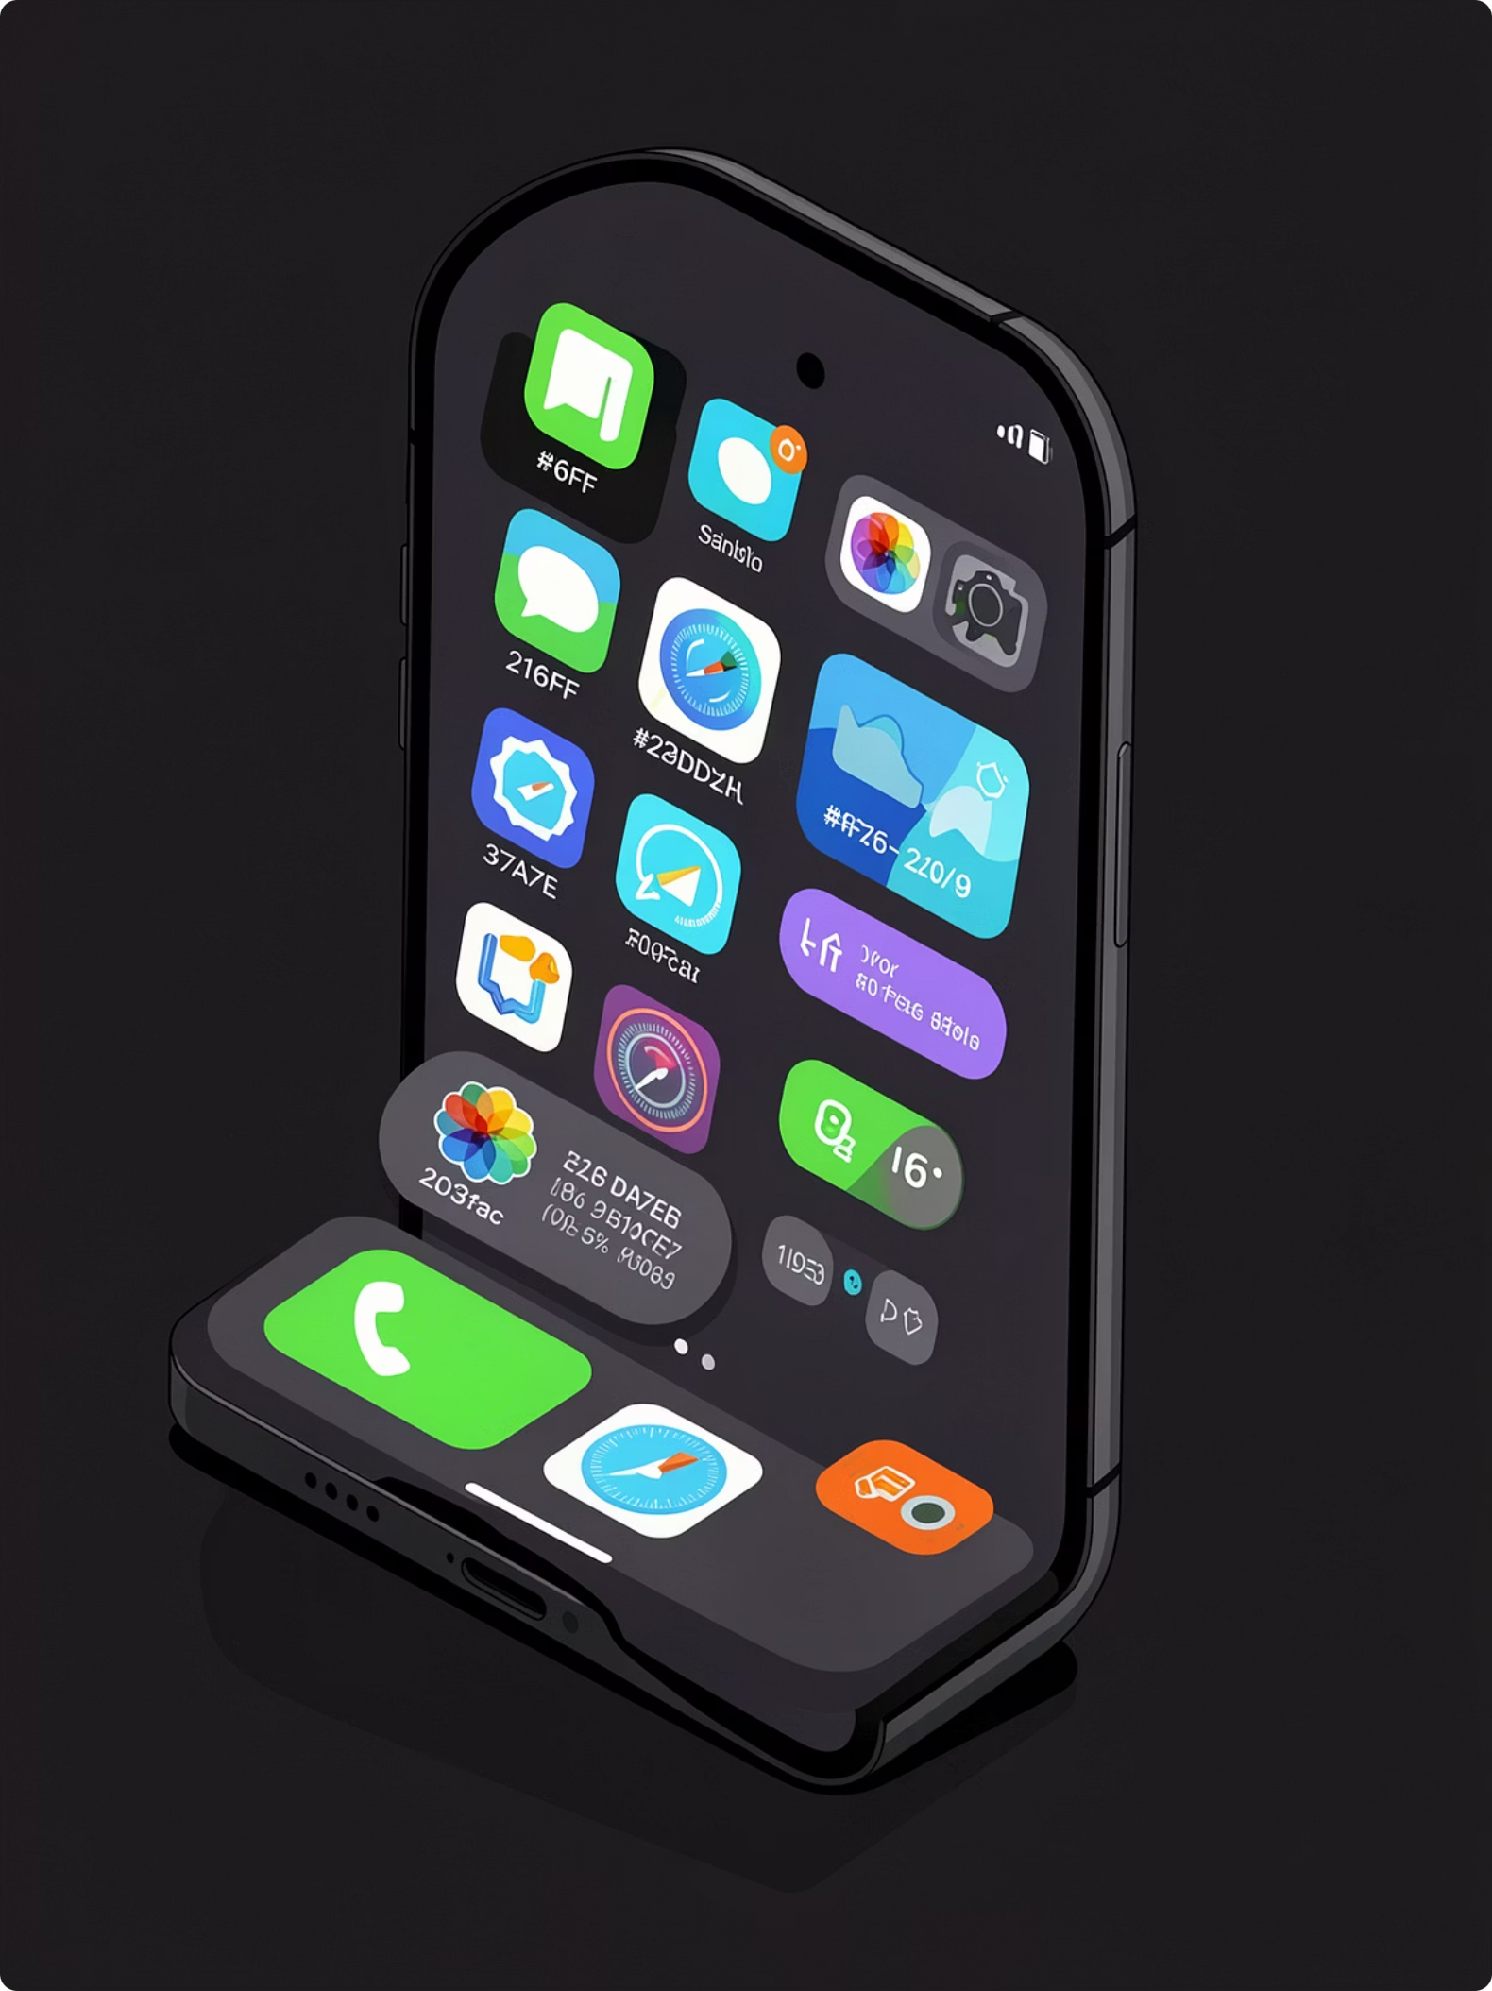

Key Features & Interface
Direct manipulation
Touch gestures (swipe, tap, pinch) plus virtual keyboard, haptics, and sensor-driven interactions.
Notifications
Expandable notifications with app actions accessible from the shade.
Multitasking
Recents/Overview, split-screen support (varies by version and vendor) and robust app switching.

Slide 6
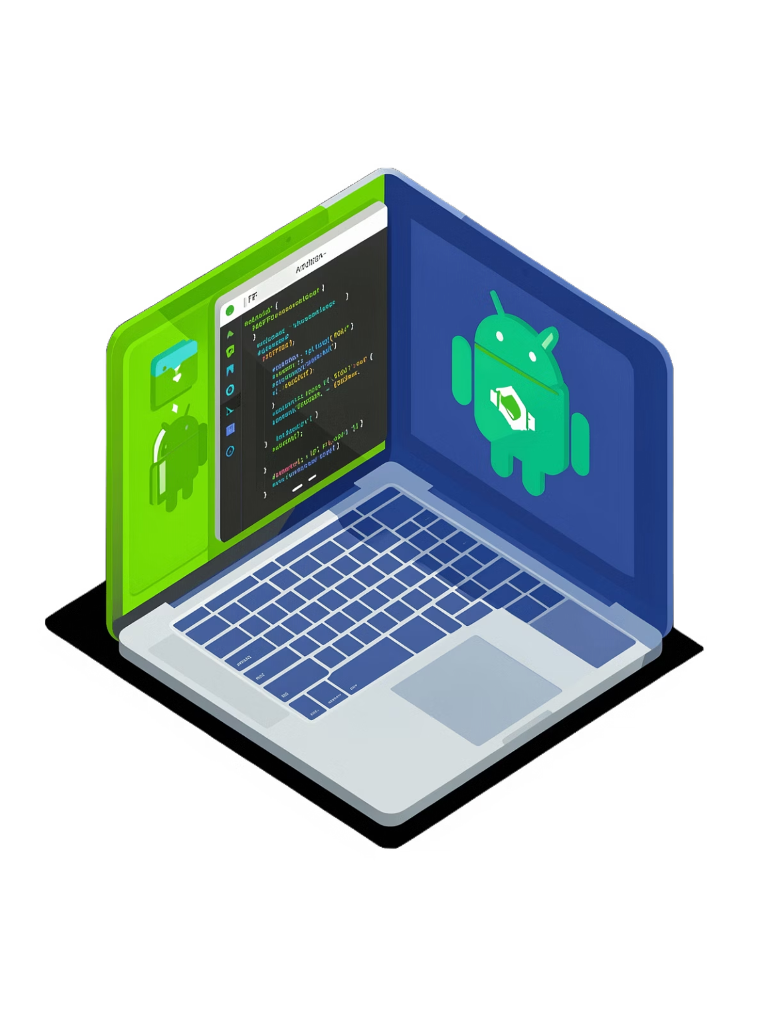
Applications & Development
Apps are distributed as APKs and commonly delivered via Google Play Store (over 3M apps historically). Developers use the Android SDK and Android Studio; Kotlin is Google’s preferred language (since 2019) while Java and C++ remain supported. Google decoupled many components (Play Services, Project Mainline) to deliver updates outside full OS upgrades.

Slide 7
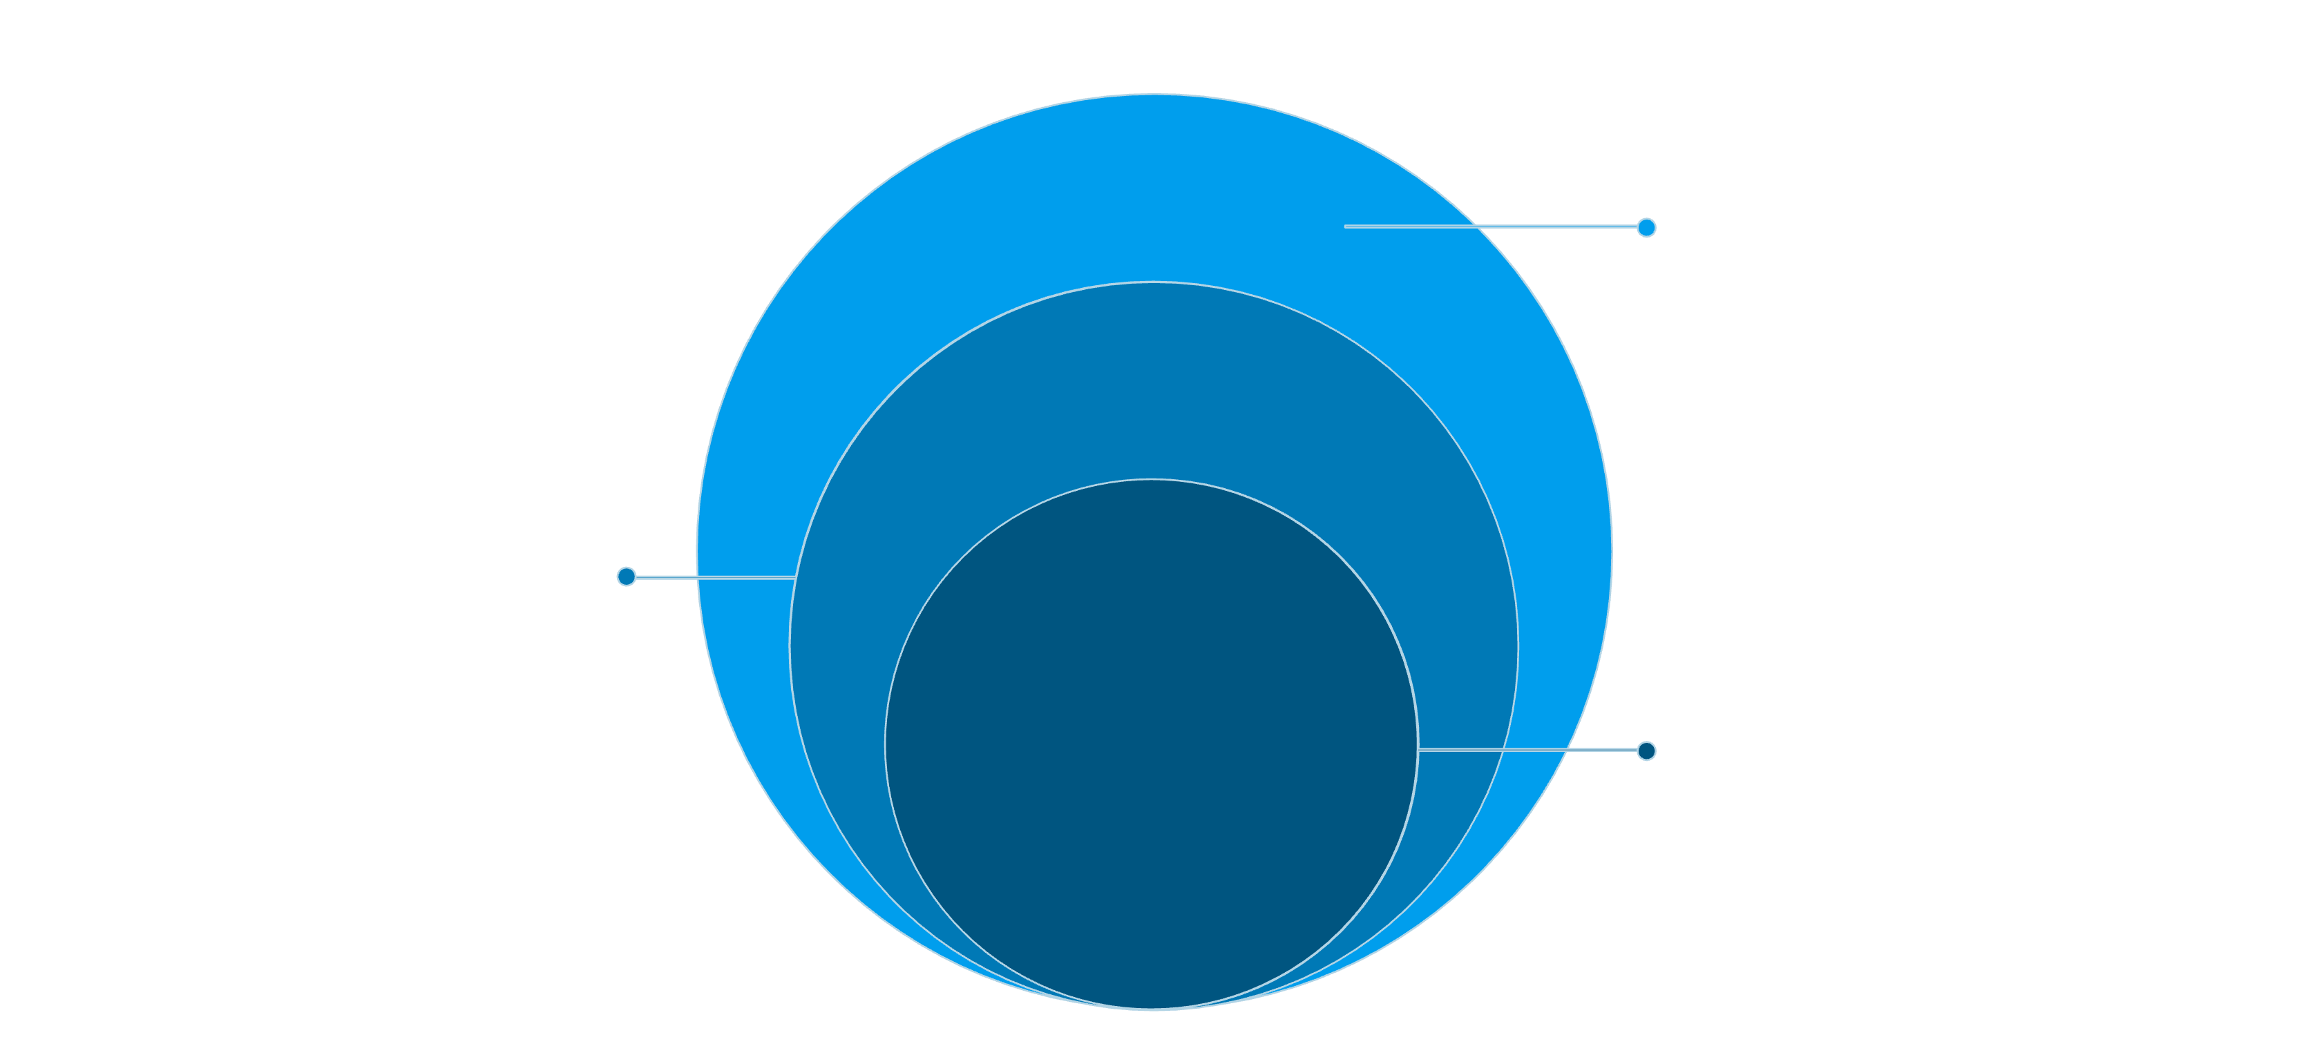
Software Architecture & Kernel
Runtime & Framework
ART, application framework, and apps
Native & Middleware
Native libs, HALs, and middleware services
Core Kernel
Linux kernel with Android subsystems
Android runs on a Linux kernel variant with additional Android-specific subsystems (ashmem, ION, wake locks). ART (Android Runtime) replaced Dalvik and compiles apps AOT. Google maintains experimental work to rebase Android on newer Linux LTS kernels; components combine open-source and proprietary pieces.

Slide 8
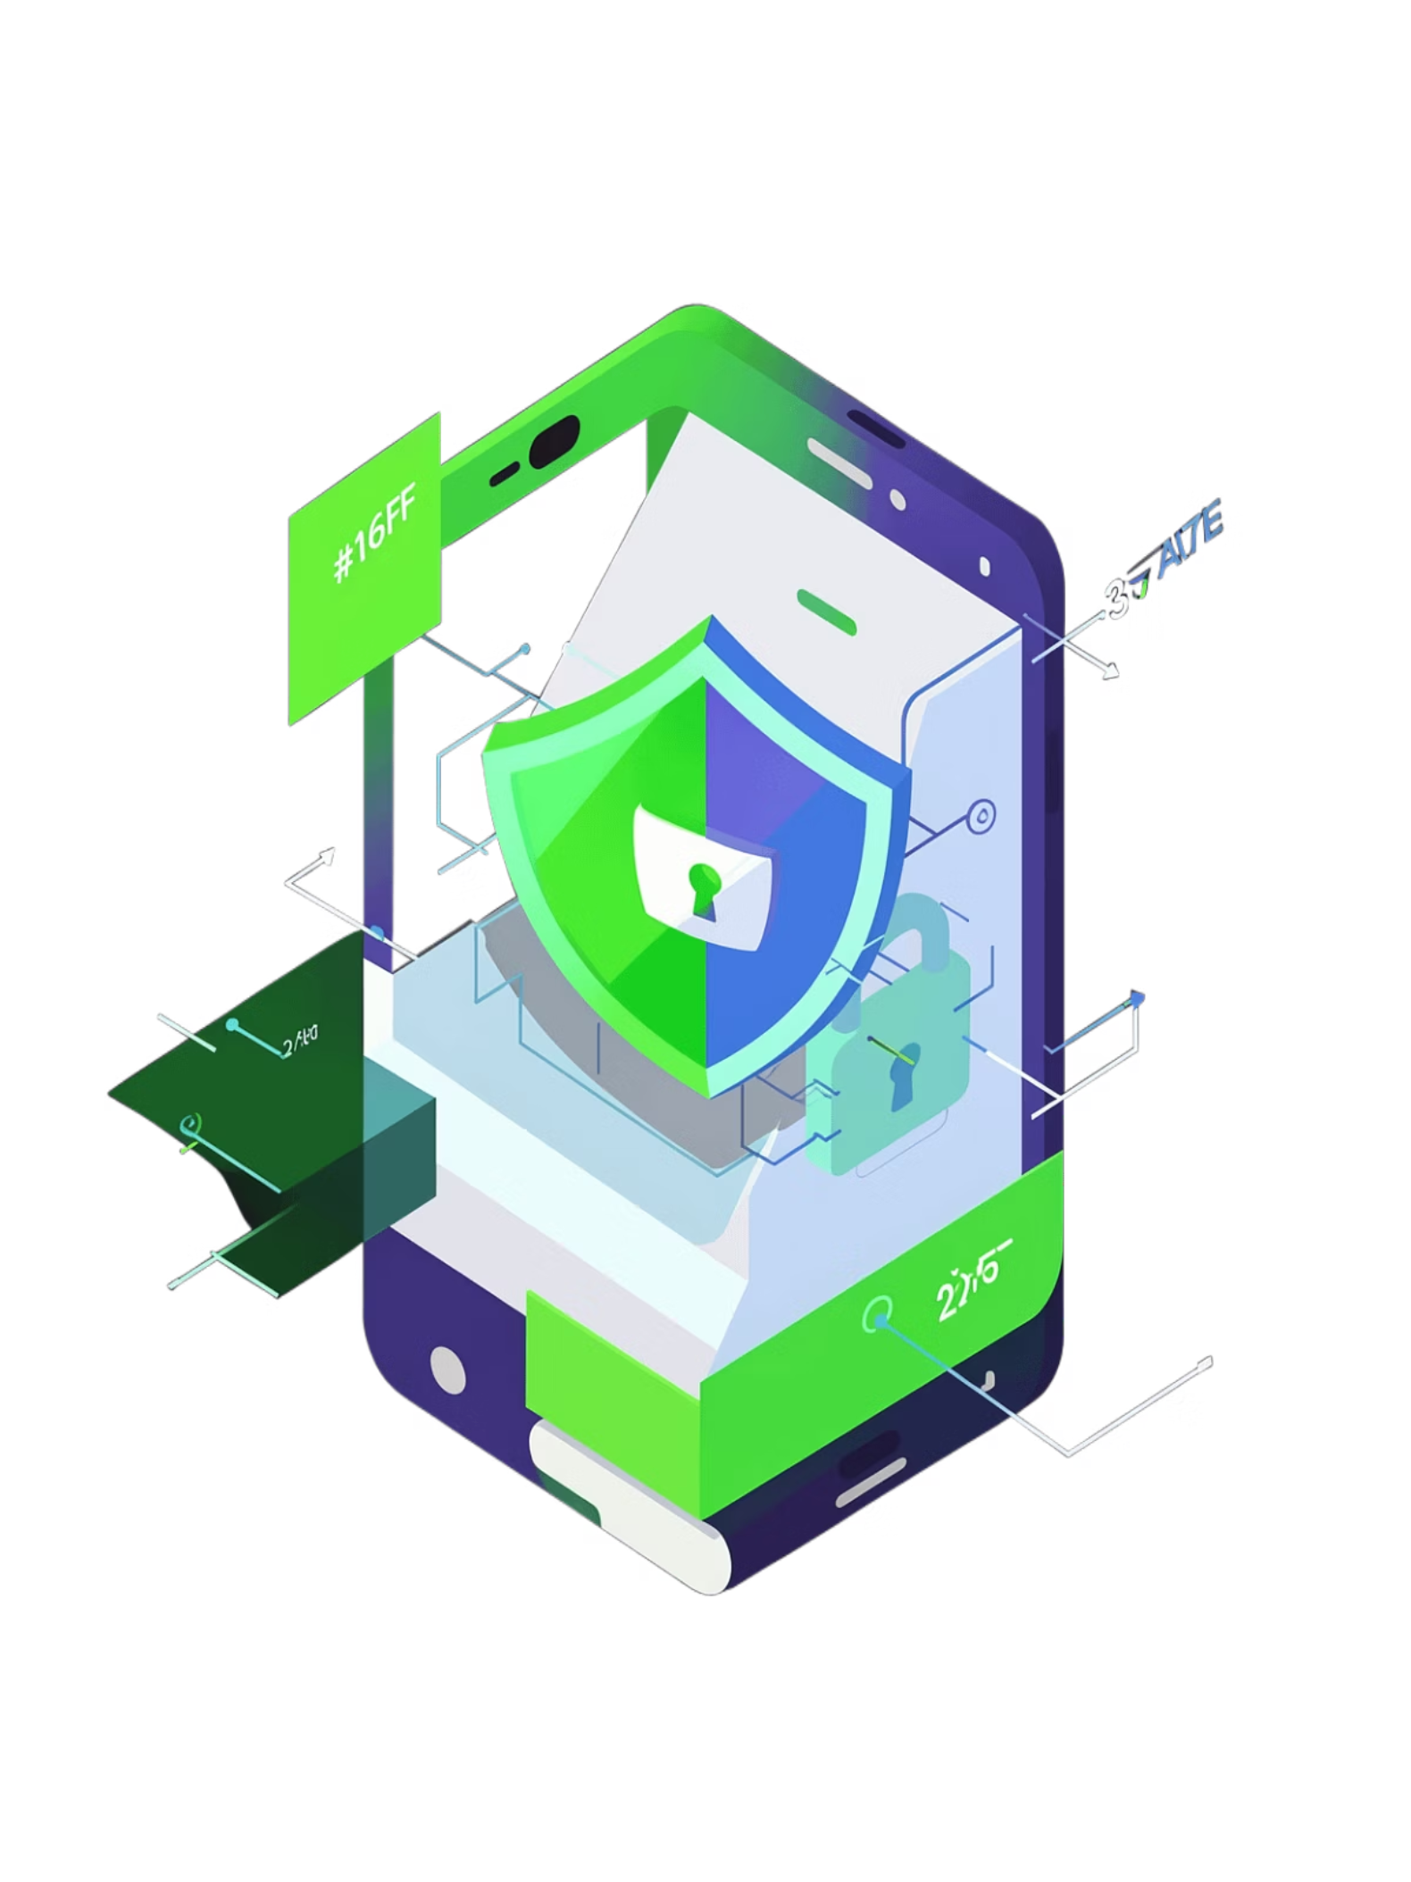
Security, Privacy & Updates
Security features
Update challenges
Sandboxed apps, Verify Apps (constant scanning), Verified Boot and dm-verity for runtime integrity.
Fragmented hardware and vendor customizations cause delayed patches; Google introduced Project Treble and Project Mainline to speed updates.
Privacy concerns
Issues include preinstalled software data collection, large-scale telemetry, and documented regulatory fines (e.g., CNIL in France, ACCC in Australia).

Slide 9
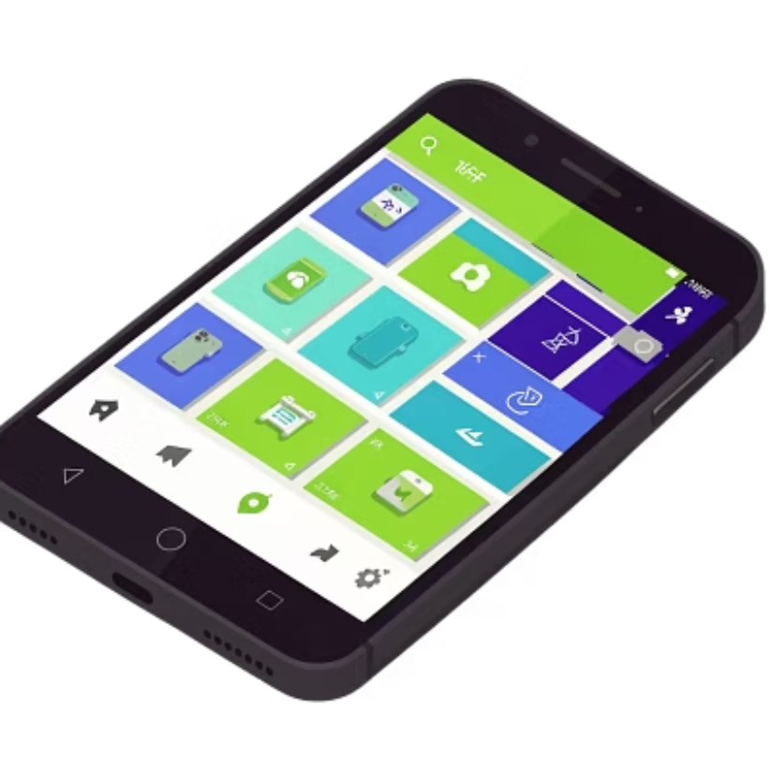
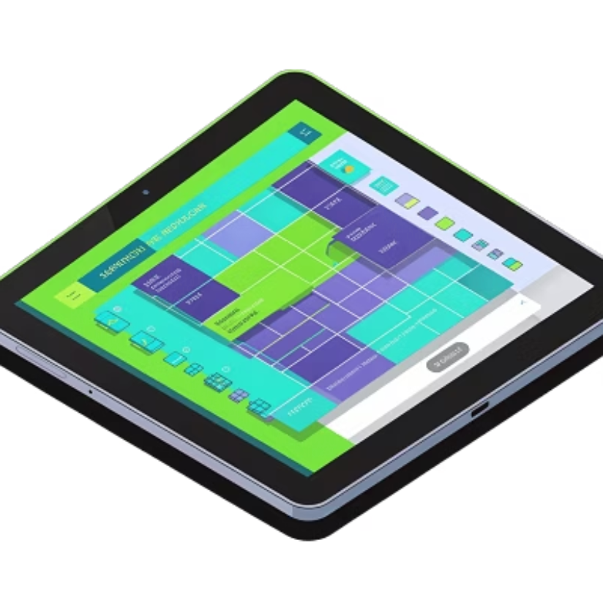
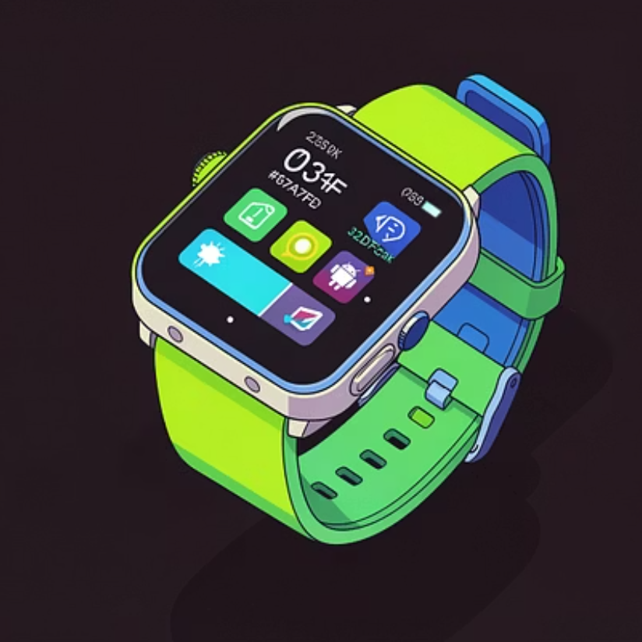
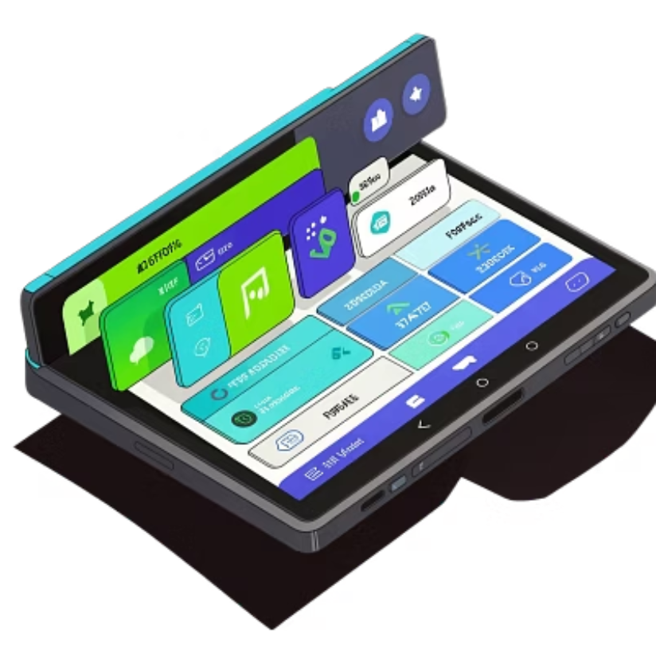
Market Reach, Devices & Variants
Android’s ecosystem spans smartphones, tablets, wearables (Wear OS), TVs (Android TV), cars (Android Automotive), XR and many embedded devices. As of Q1 2025 Android held roughly 76% mobile market share globally and powers billions of active devices worldwide.

Slide 10
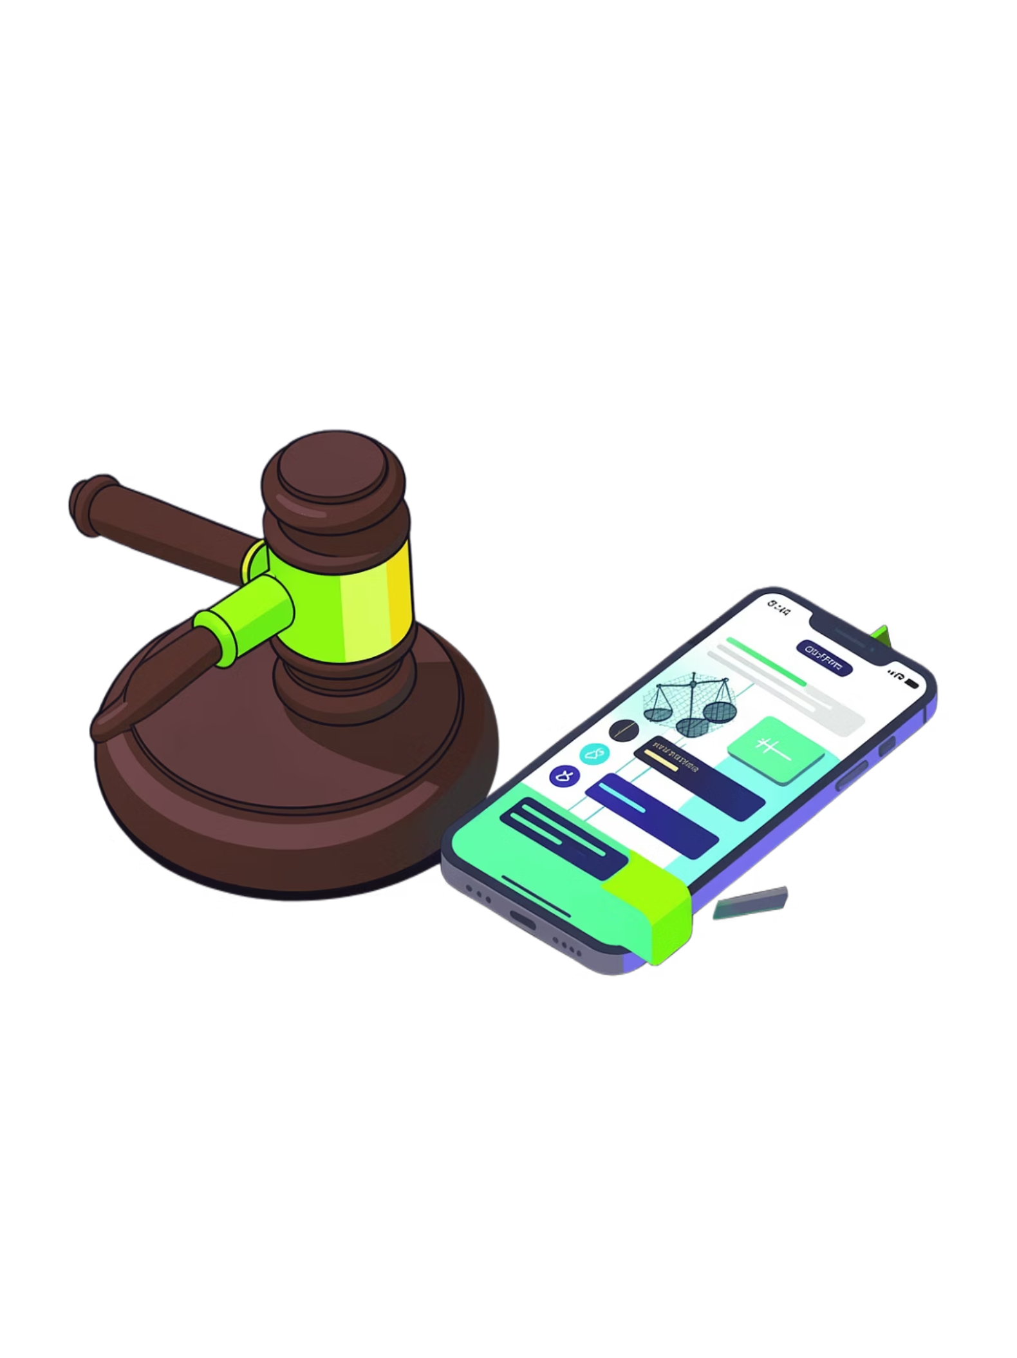
Criticism, Legal & Regulatory Issues
1
2
3
Antitrust
Privacy fines
Fragmentation & short support
EU antitrust rulings fined Google and forced changes to distribution of GMS and bundling rules in Europe.
Regulators have penalized Google for data and disclosure practices (e.g., France, Australia, U.S. state attorneys general settlements).
Criticized for short device support lifecycles; efforts like Treble, Mainline, and OEM commitments (e.g., Samsung extended support) aim to improve this.

Slide 11
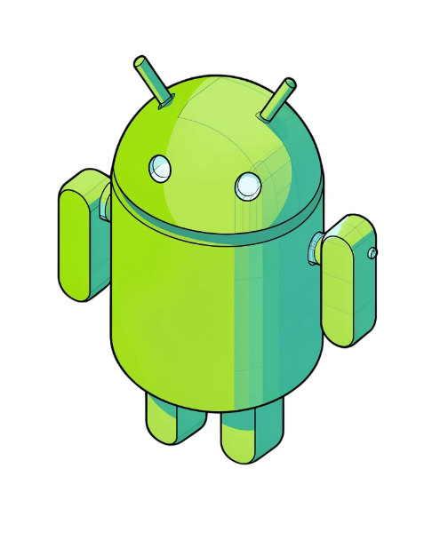
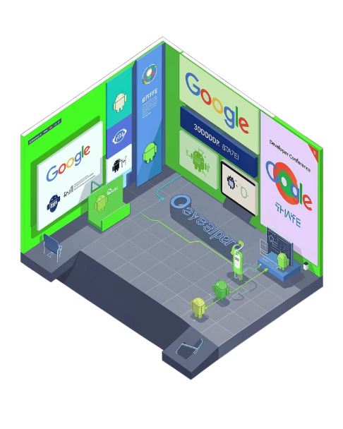
Legacy, Reception & Future Directions
Mascot & branding
Ongoing evolution
The green robot (often called "Bugdroid", officially "The Bot" in 2024) is Android’s widely recognized mascot. The wordmark/logo evolved and is used with trademark restrictions by Google.
Google continues to develop Android (annual major releases; Android 16 released June 10, 2025) and expand into XR, desktop-like experiences, and tighter modular update delivery while balancing openness, security and regulatory constraints.

Slide 12
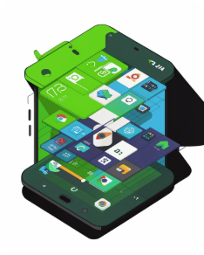
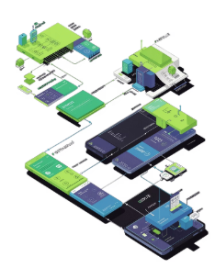
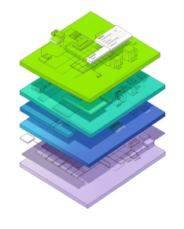
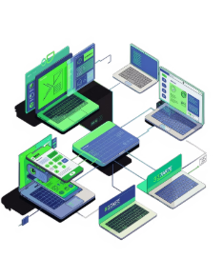
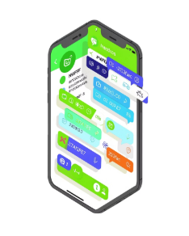
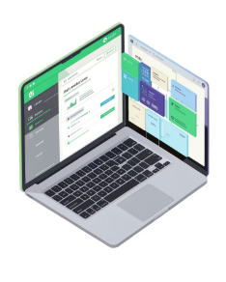
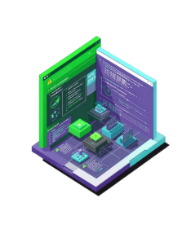
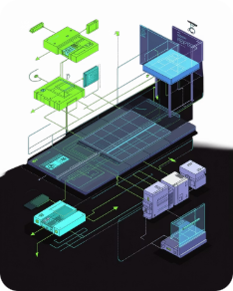
Summary & Key Takeaways
What is Android?
Origins
Architecture
Ecosystem
Key Features
Development
Challenges
Future

Slide 13
Question ?
How does Android's layered architecture help it run on such a wide range of devices?
Why has Android become so dominant in the global smartphone market, and what trade-offs come with that scale?
What do you think will matter most for Android’s future: security and privacy improvements, faster updates, or new AI-powered features?
Notes:
title question

Slide 14
Thank you for your time and attention.

